Slide 1
Bike Purchase Behavior & Customer Insights
Megada Triveni || 05-06-2026

Slide 2


The Strategic Framework: Focus Areas
The Business Problem
Marketing spend suffers from diluted returns due to generic audience segmentation.
The Analytical Goal
Integrate analytical findings into a dynamic, real-time Excel Dashboard that guides targeted regional expansion and sales operations.

Slide 3
The Foundation: Global Scale & Baseline KPIs
Total Sample Size
1,000
Total Bikes Sold
481
Baseline Conversion Rate
48.10%
Top Market Indicator
58.85%

Slide 4
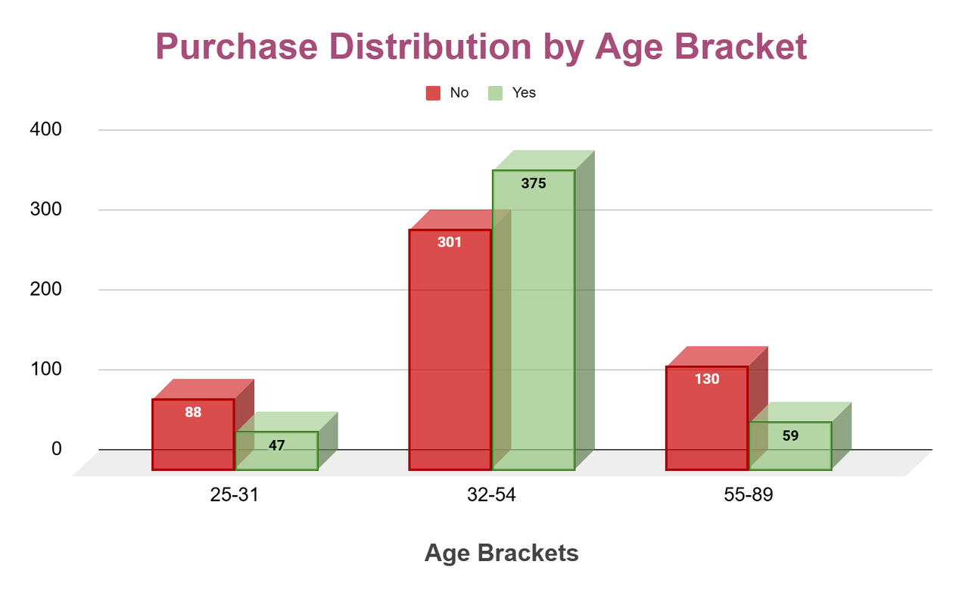
Age Brackets vs. Purchase Rate
The Golden Segment (31–40): Converts at an exceptional 61.08%, making up the largest sales volume (193 bikes).
The Bookend Drop-offs: Seniors (>60) convert at only 30.00%, while young adults under 30 drop down to 35.45%.

Slide 5
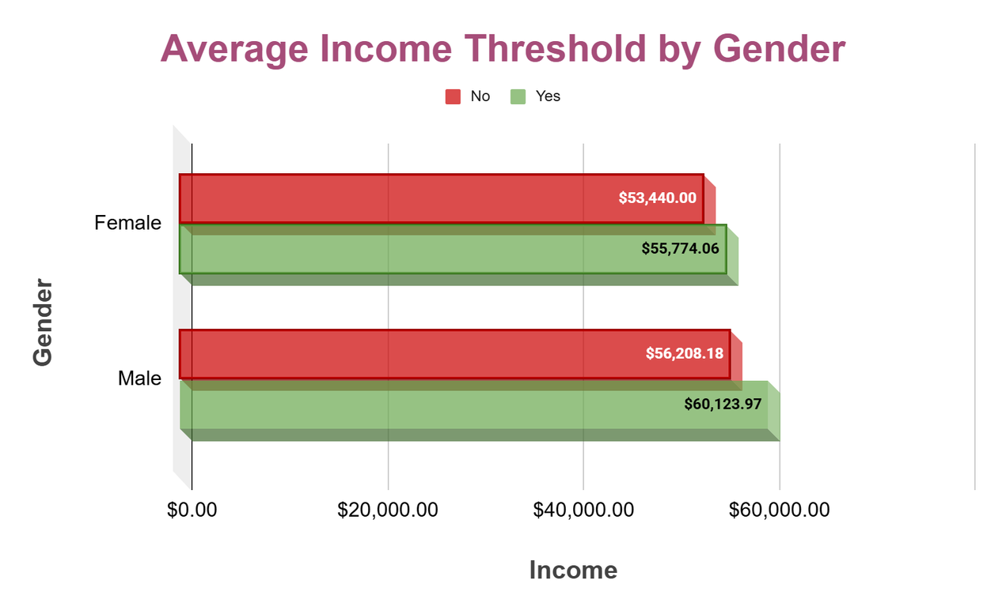
Average Income & Gender Impact
The Male Premium: Male buyers require a higher average income threshold, converting at $60,124
Consistent Female Base: Female buyers convert at a lower average income threshold of $55,774, maintaining a slightly higher overall rate of 48.88%.

Slide 6
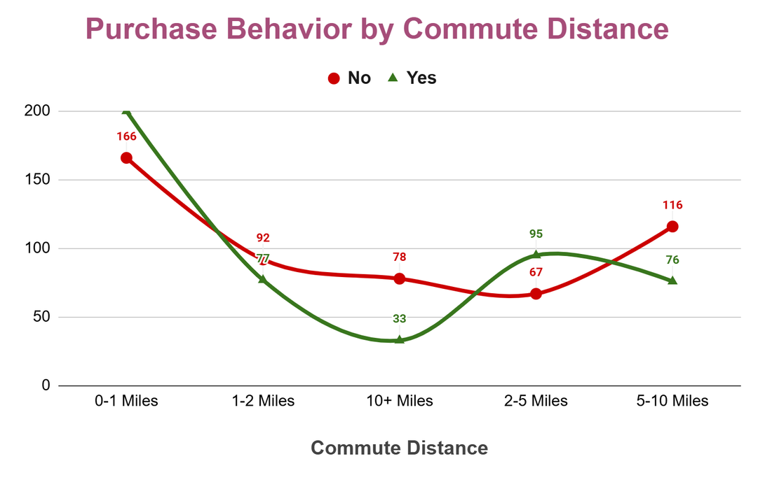
Purchase Rates by Commute Distance
The 2–5 Mile Peak (58.64%): Slightly too long to walk, making the bicycle an ideal utility replacement for car or transit travel.
The 0–1 Mile Anchor (54.64%): Highly responsive group utilizing bikes for quick local errands.
The 5-Mile Fatigue Wall: Conversions plummet to 29.73% once commutes cross the 10-mile threshold.

Slide 7
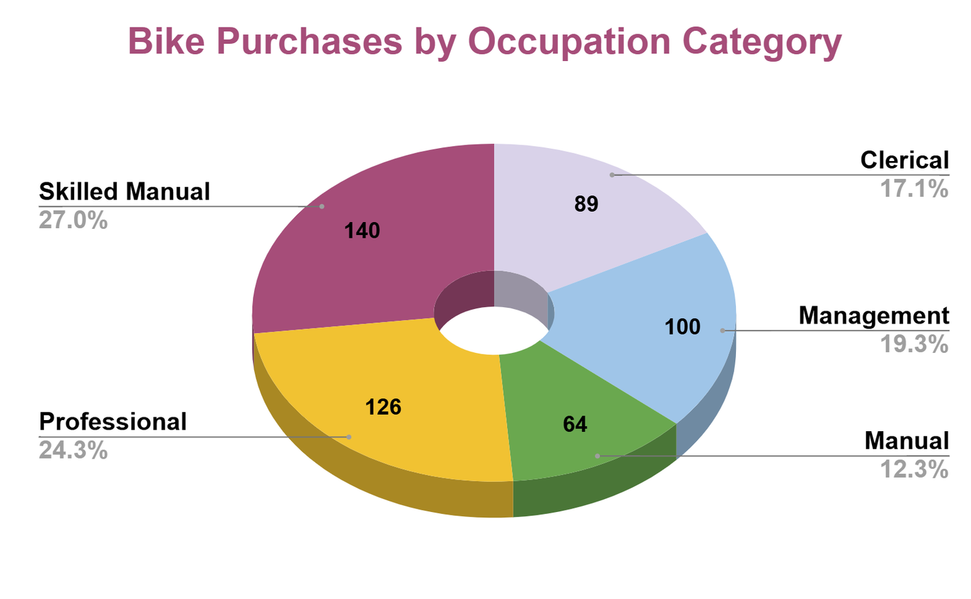
Bike Purchases by Occupation
The Professional Vanguard: White-collar creative/technical roles lead conversion at 54.35% (150 total purchases).
The Management Gap: Management represents the lowest conversion rate (42.20%), identifying a key unaddressed segment.

Slide 8
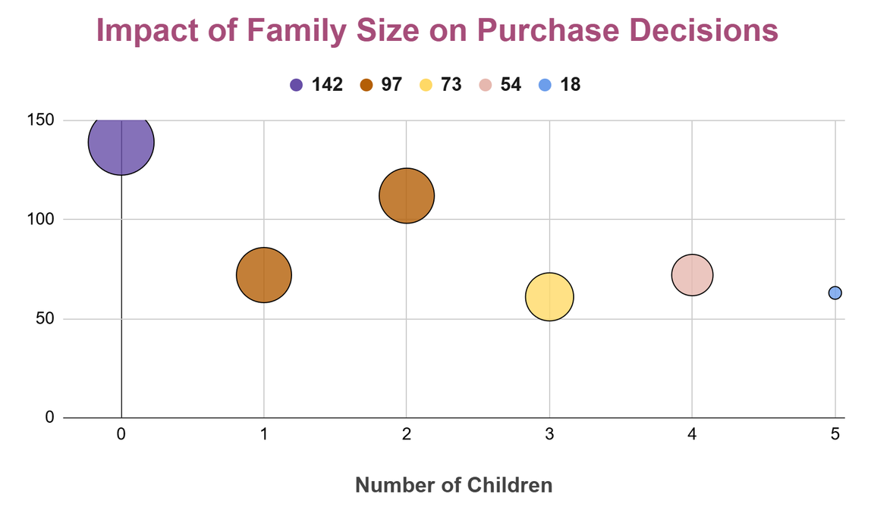
Domestic Demographics
The Single Lifestyle Booster: Single prospects convert at a high rate of 54.11% (250 sales), compared to Married prospects at 42.94%.
The One-Child Peak Sweet Spot: Households with exactly 1 child lead conversion at 57.40%.
The Big Family Drop: Having 5 children causes conversion to plummet to a low of 22.22%.

Slide 9
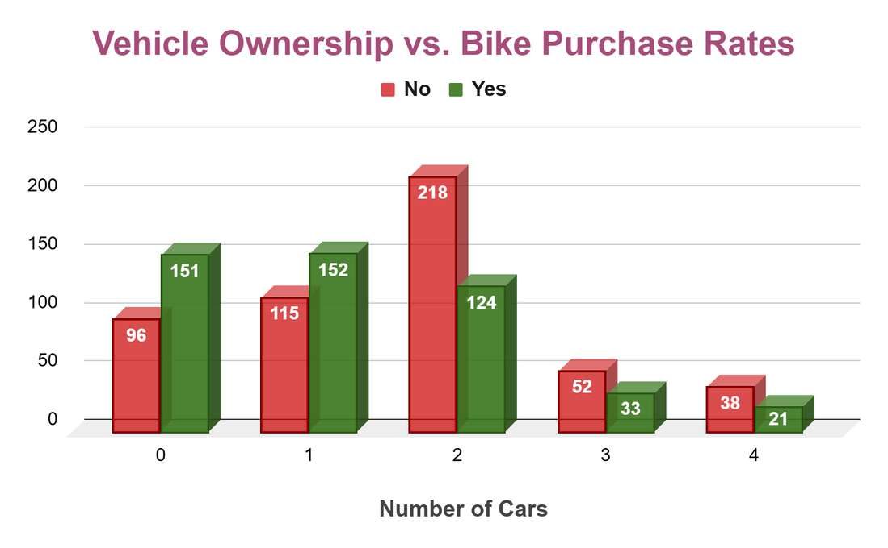
Vehicle Ownership vs. Bike Purchase Rates
0-1 Car Threshold: Owning 0 cars (61.13%) or 1 car (56.93%) correlates with highly motivated buyers.
The 2+ Car Drop: The moment a household scales to 2 or more cars, conversion rates drop sharply to 36.12%.

Slide 10
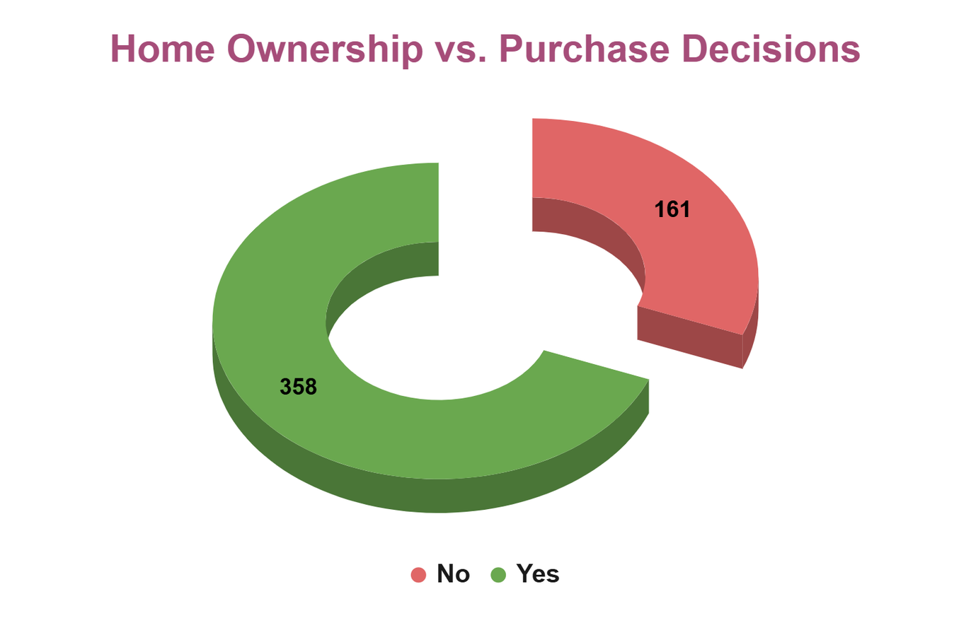
Home Ownership vs. Purchase Decisions
The Homeowner Stability Booster: Home ownership boosts clerical and manual purchase rates, but actually decreases management purchase rates.

Slide 11
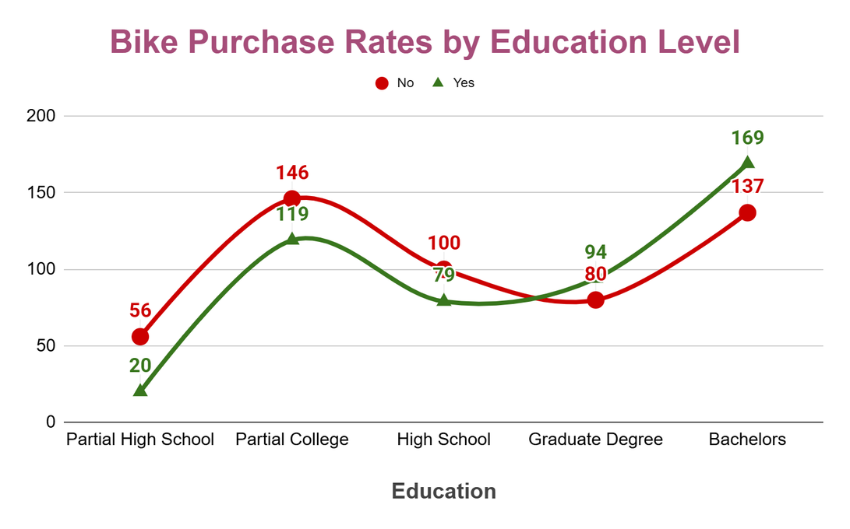
Education Level vs. Purchase Decisions
The High-Performing Tiers: Bachelors Degree holders lead conversion at 55.23%, with Graduate Degree holders close behind at 54.02%.
The Partial High School Drop-off: Conversions drop significantly to only 26.32% among those with partial high school education.

Slide 12
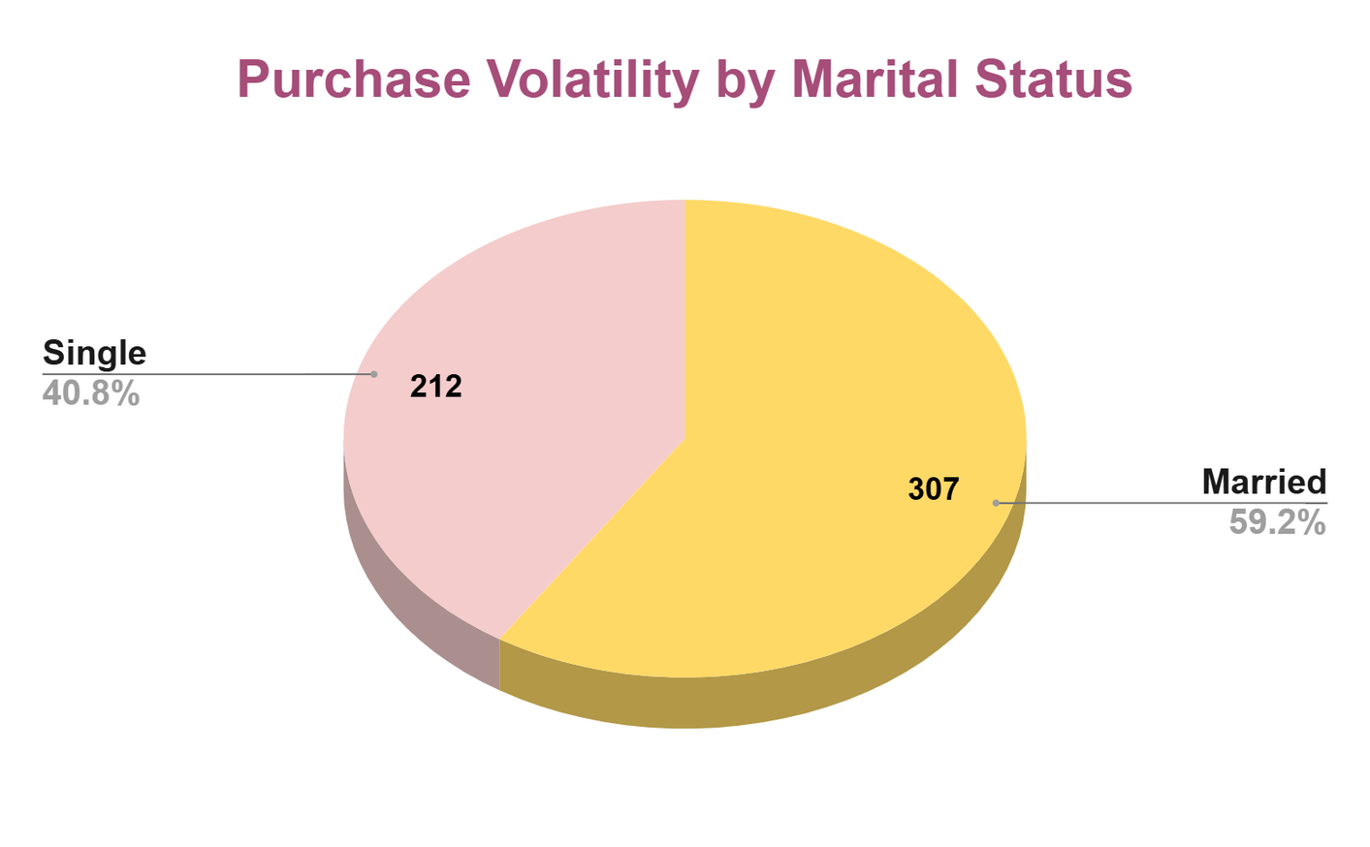
Purchase Volatility by Marital Status
Single prospects represent your highest-converting segment at 54.1% (250 sales), presenting a highly agile market with fewer shared household expenses .
Married households see conversion drop significantly to 42.9% (an 11.2% performance gap), indicating the domestic financial obligations.

Slide 13
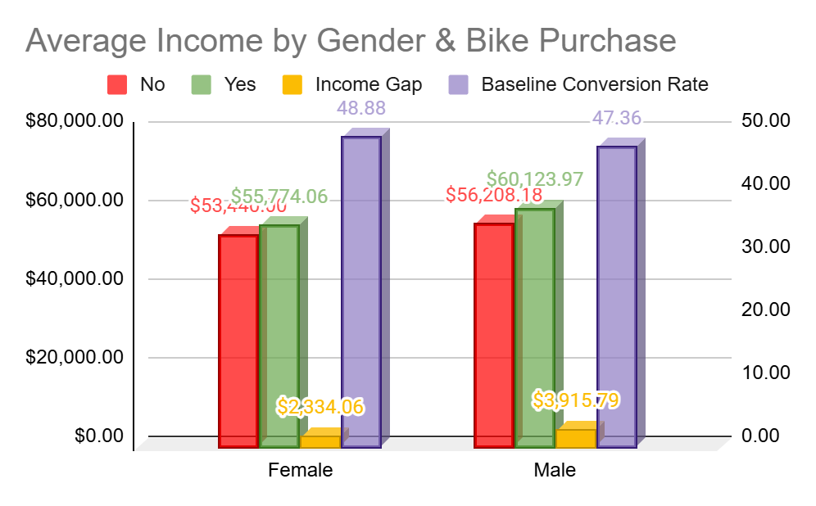
Average Income by Gender & Bike Purchase
For both genders, bike buyers possess a higher financial baseline than non-buyers. Male purchasers command the highest premium with an average income of $60,124 (compared to $56,208 for male non-buyers), proving that higher disposable income directly unlocks purchasing intent.

Slide 14
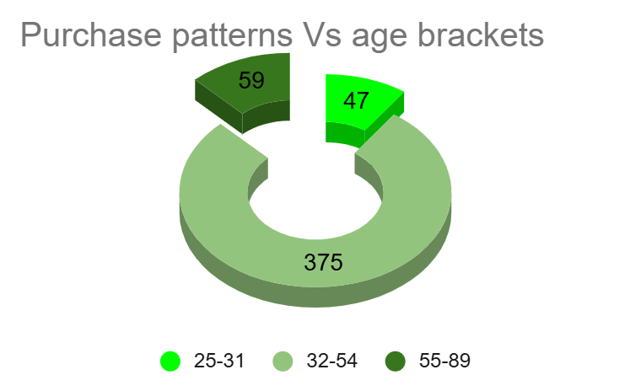
Purchase patterns Vs age brackets
For both genders, bike buyers possess a higher financial baseline than non-buyers. Male purchasers command the highest premium with an average income of $60,124 (compared to $56,208 for male non-buyers), proving that higher disposable income directly unlocks purchasing intent.

Slide 15
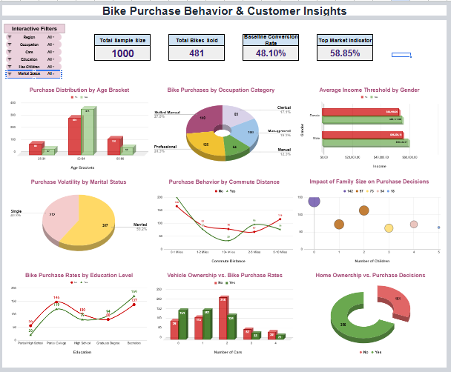
DashBoard

Slide 16


Recommendations
Prioritize High-Conversion Niches:
Shift marketing resources away from low-performing clusters and focus heavily on Professionals and Single customers .
Launch Regional Aggressive Campaigns:
Target the Pacific region, which represents our highest-performing market with a remarkable 58.9% conversion rate (113 sales out of 192 total prospects)

Slide 17


Conclusion
The Demographics of Intent:
Bike purchase decisions are heavily dictated by lifestyle constraints. The core of our commercial volume rests on the 32–54 age bracket (contributing 375 sales / 55.5% conversion)
The Asset Threshold:
Operational data reveals that micro-mobility assets act as a direct alternative to vehicle congestion.

Slide 18
Thank You

